Slide 1
Buffalo Waterways Project Proposal
BY: Riley Blasiak
02/12/25

Slide 2
Background and Motivation
Buffalo has combined sewer overflows that effect surface water quality.
This surrogate model will be used to simulate water quality in local rivers.
The model will be able to determine how combined sewer outfall locations may affect surface water quality. Allowing for us to determine where engineering intervention is needed.

Slide 3
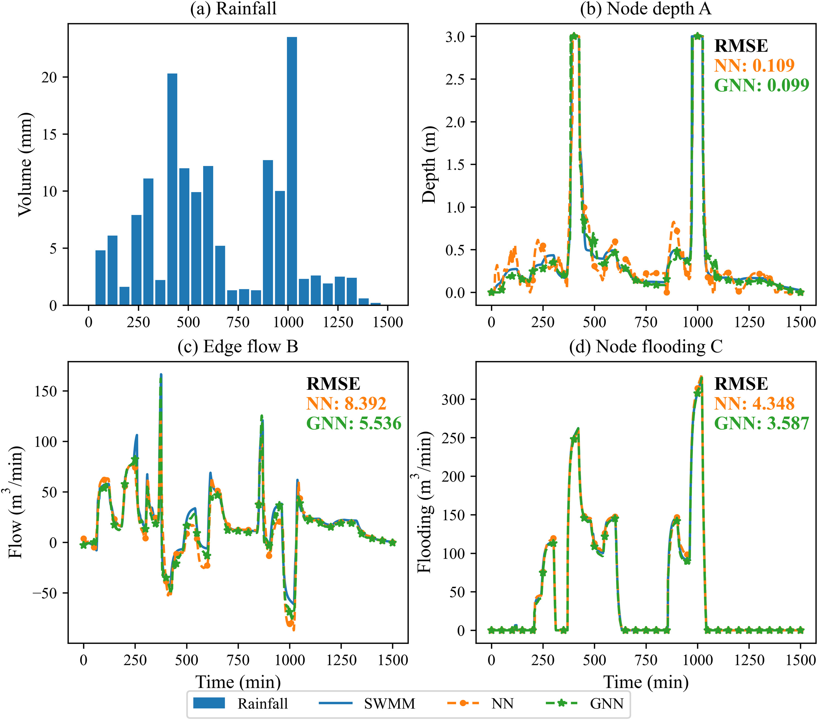
A deep learning algorithm for multi-source data fusion to predict water quality of urban sewer networks
GNN-based surrogate of the flow routing model for the hydraulic prediction in drainage networks
Notes:
A deep learning algorithm for multi-source data fusion to predict water quality of urban sewer networks – ScienceDirect
https://www.sciencedirect.com/science/article/pii/S0959652621027426

Slide 4
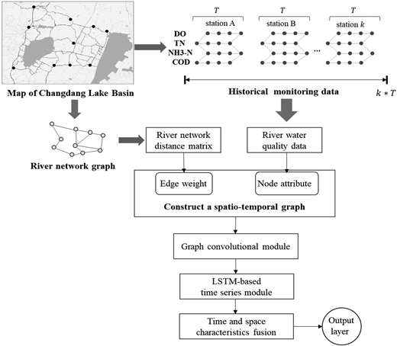
A deep learning model with spatio-temporal graph convolutional networks for river water quality prediction
Achieved accurate water quality prediction at different river locations.
Considers spatial dependencies that other deep learning models neglect.
Notes:
A deep learning model with spatio-temporal graph convolutional networks for river water quality prediction | Water Supply | IWA Publishing
https://www.sciencedirect.com/science/article/pii/S0925231224006325

Slide 5
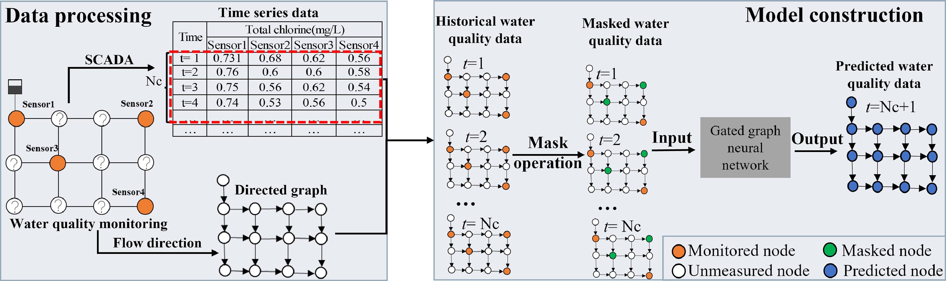
Real-time water quality prediction in water distribution networks using graph neural networks with sparse monitoring data
high predictive accuracies (Mean Absolute Error = 0.07 mg L⁻¹ and Mean Absolute Percentage Error = 10.0 %) across the entire network including those unmonitored sites.
Notes:
https://www.sciencedirect.com/science/article/pii/S0043135423014586

Slide 6
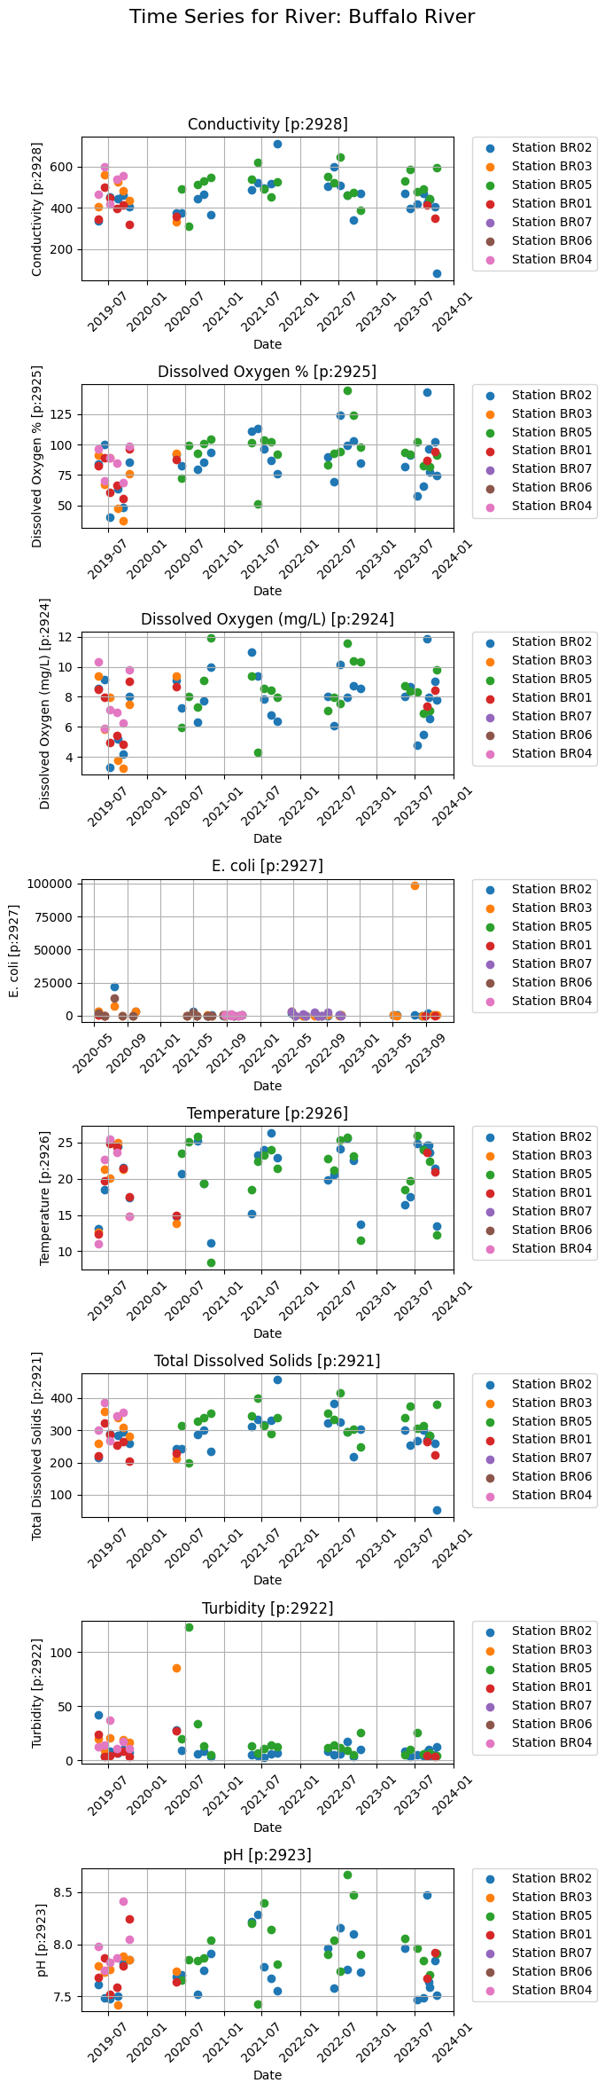
Background (What data do we have)

Slide 7
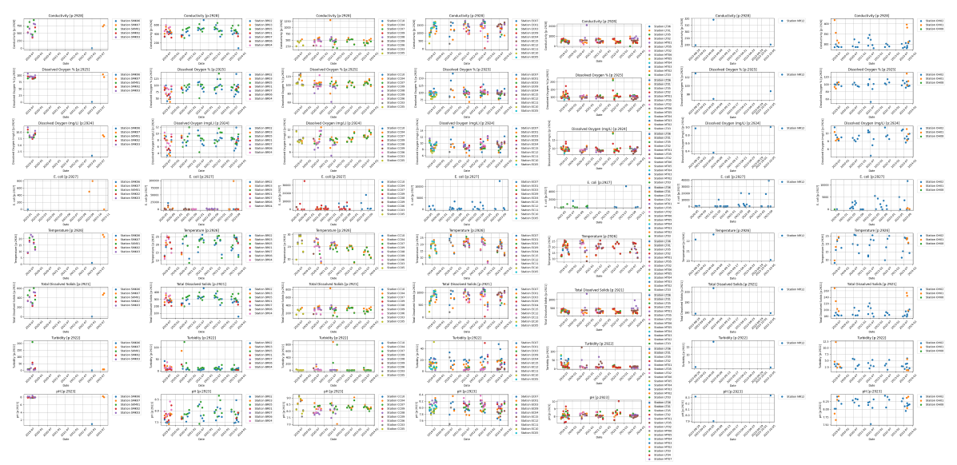
Background (What data do we have)

Slide 8
Background (What data do we have)
Total number of samples: 4734 with up to 8 parameters each
Number of unique years sampled: 10
Number of different rivers sampled: 38

Slide 9
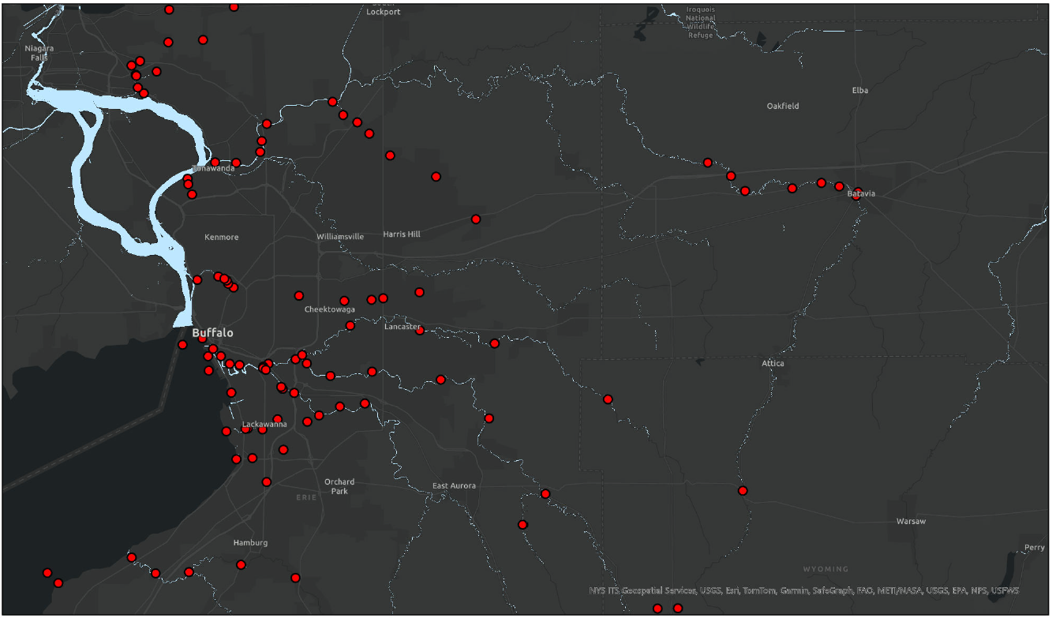

Slide 10
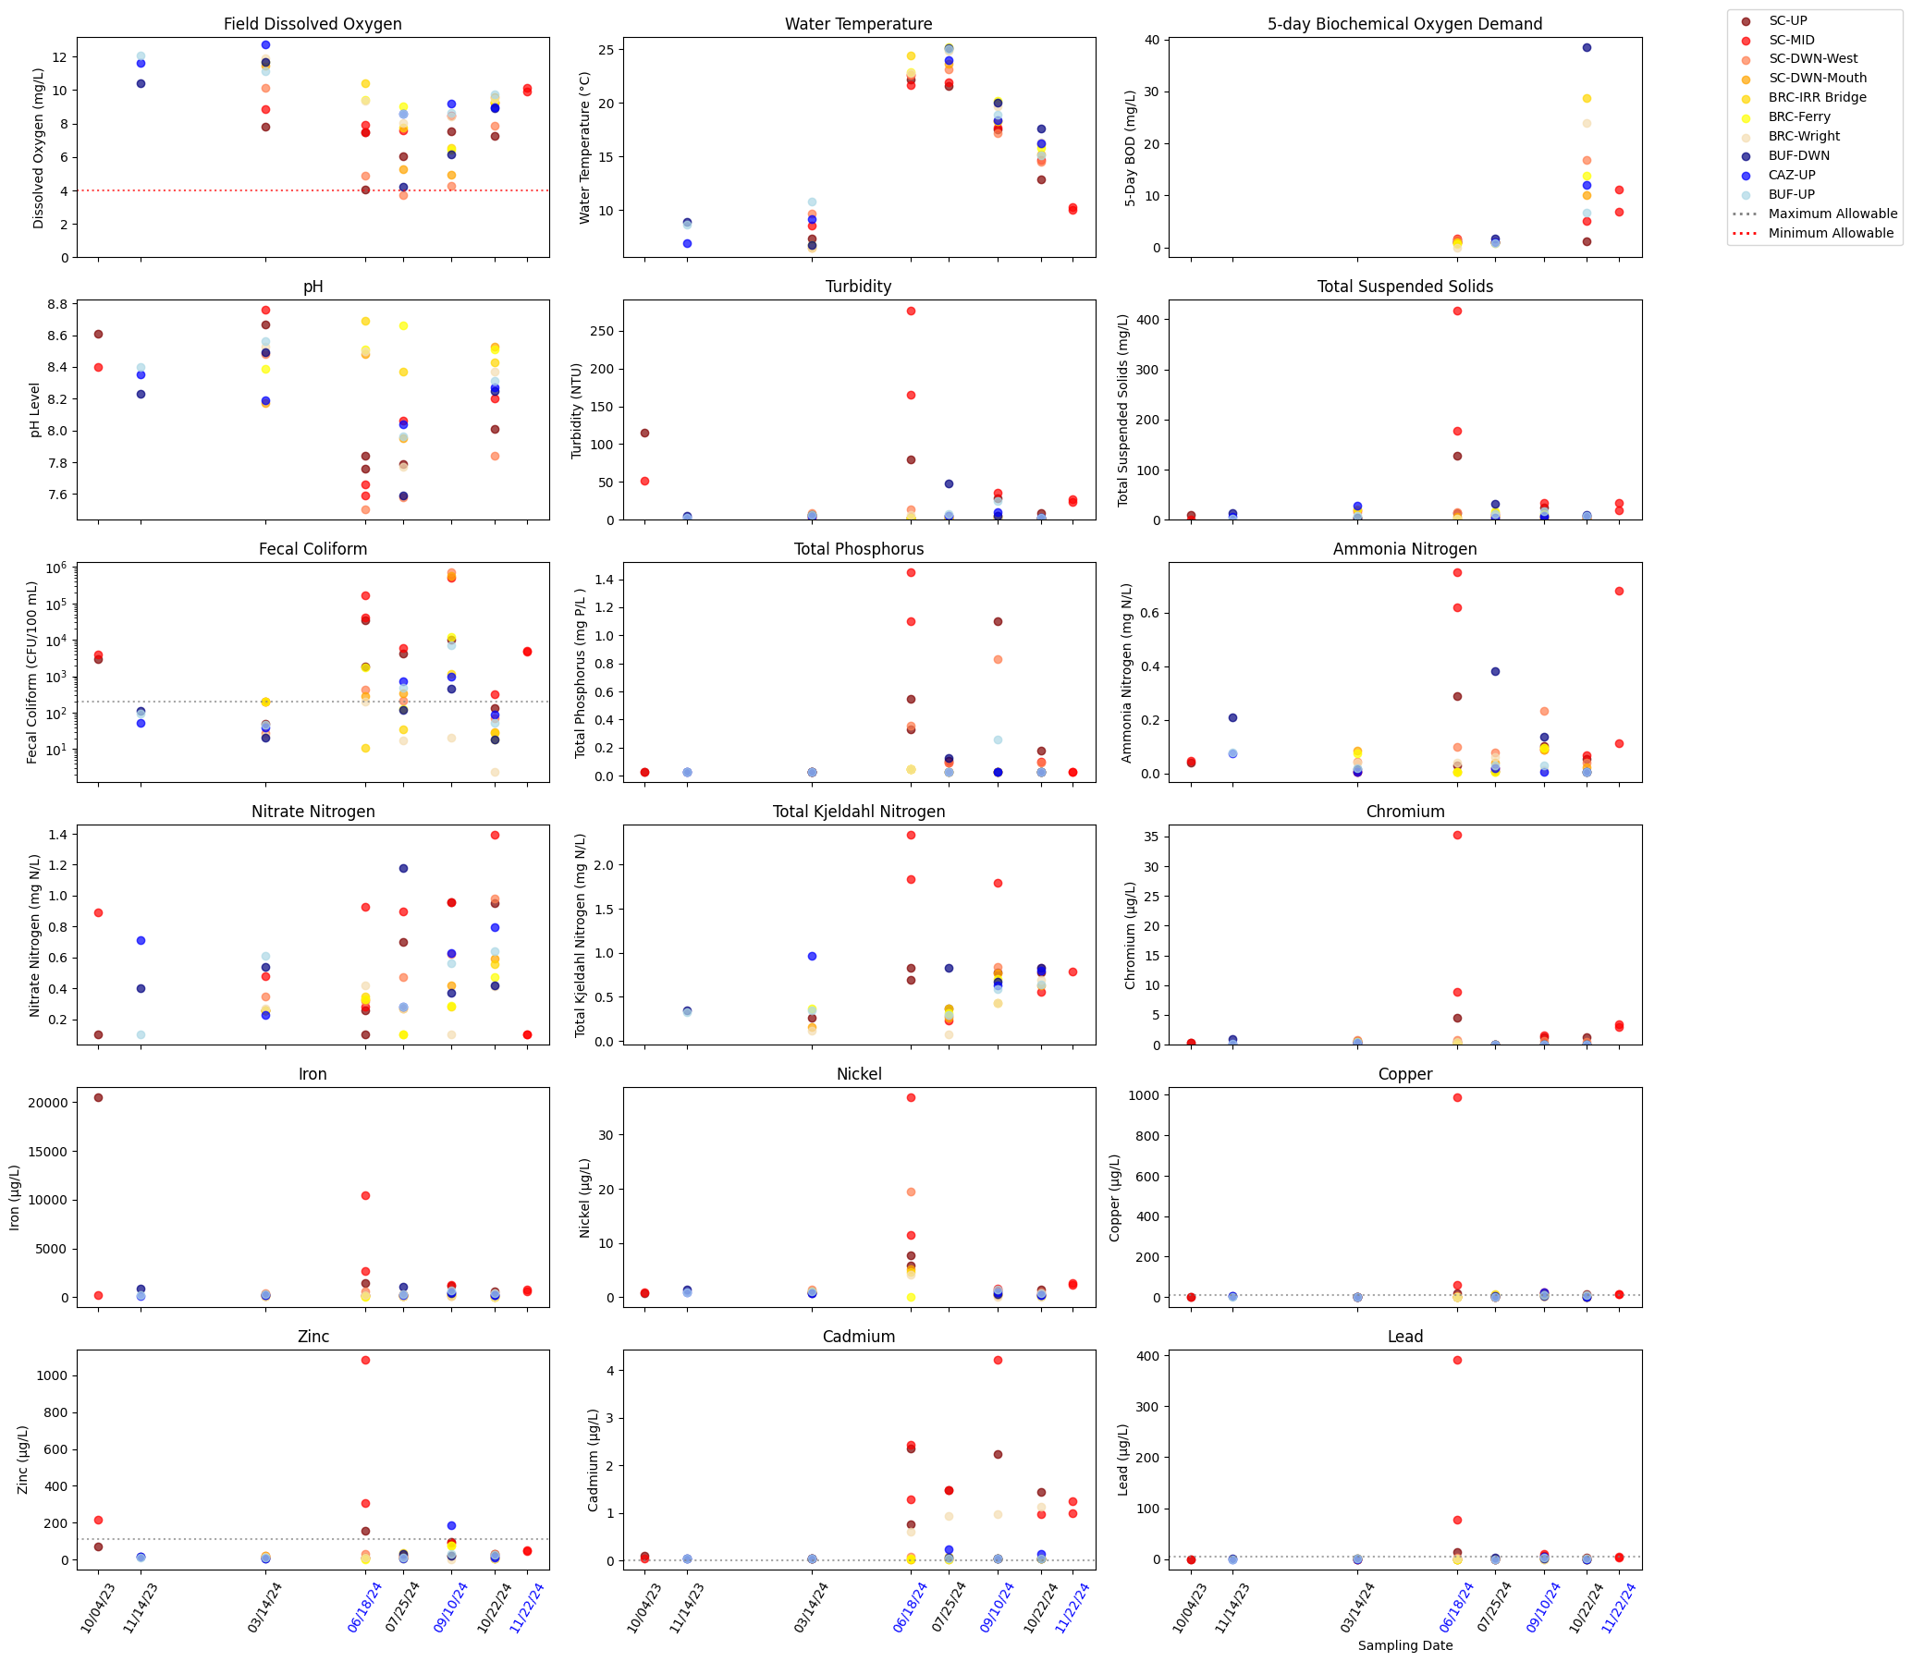
Background (What data do we have)
UB Surface Water Samples

Slide 11
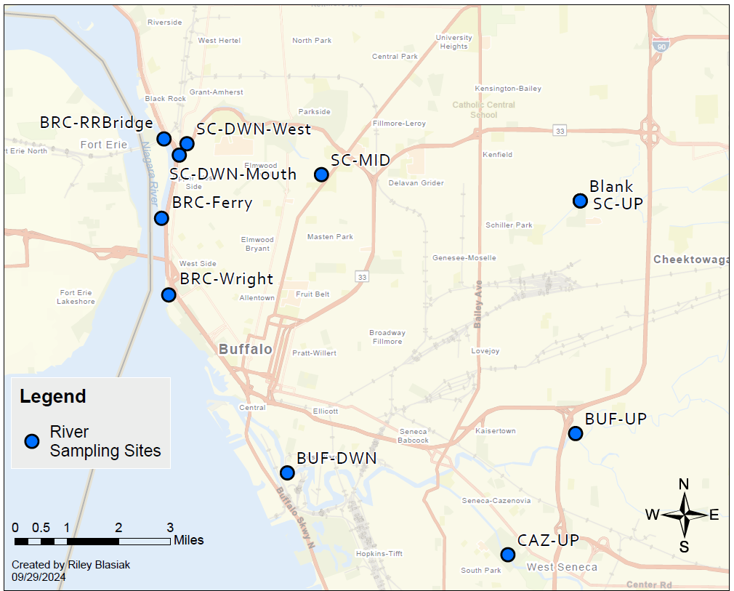

Slide 12
Questions:
Can we predict surface water quality accurately using graph neural network given BNW data and UB surface water samples?
Can we determine which locations are the most important for improving water quality?
Do important locations correlate with combined sewer discharge locations?
Can we use water quality indicators that are easy to measure to predict harder to measure parameters?
Notes:
Questions for audience:
Background: Surrogate models using GNNs to predict river water quality
Motivation: Lacking__ improve water quality
How is the project related to the class: utilizes network systems and network based analysis
If you are doing this (suggestions): Seasonal flow of rivers. GNN dynamic structure; add nodes or edges based on season
One network river system

